Slide 1
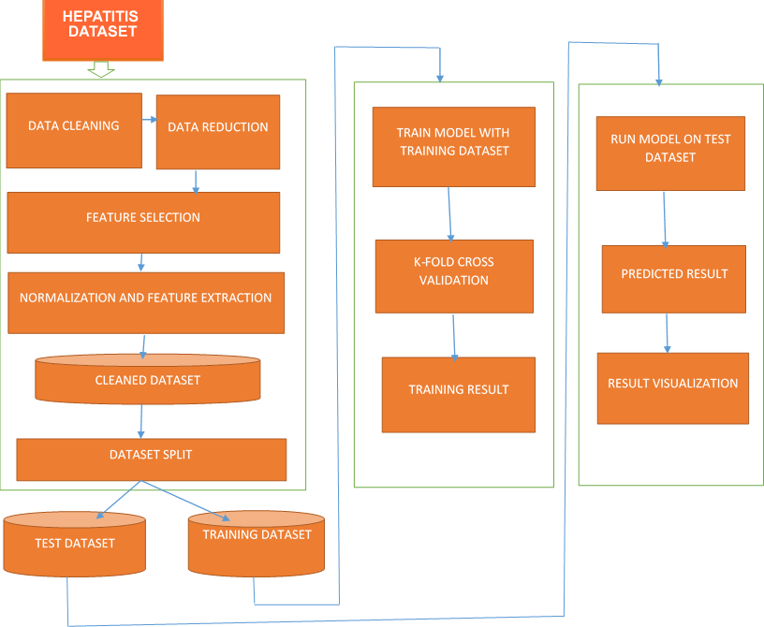
HEART DISEASE
DATASET

Slide 2
